Slide 1
HOW TO WRITE TEST CASES:
TEST CASE TEMPLATE WITH EXAMPLES
Prepared By: Dr.V.Arulkumar, Asst.Prof, IT

Slide 2
WHAT IS A TEST CASE?
A test case template is a document that comes under one of the test artifacts, which allows testers to develop the test cases for a particular test scenario in order to verify whether the features of an application are working as intended or not.
Test cases are the set of positive and negative executable steps of a test scenario which has a set of pre-conditions, test data, expected results, post-conditions, and actual results.
Most of the companies are using test case management tools such as Quality Center (HP QC), JIRA, etc., and some of the companies still using excel sheets to write test cases.

Slide 3
WHAT IS THE DIFFERENCE BETWEEN TEST SCENARIO VS TEST CASE?
Test Scenario: Test Scenario gives the idea of what we have to test. Test Scenario is like a high-level test case.
For example: Verify the login functionality of the Gmail account.
Assume we need to write test cases for a scenario (Verify the login of the Gmail account).
Here are some test cases.
1. Enter valid User Name and valid Password
2. Enter valid User Name and invalid Password
3. Enter invalid User Name and valid Password
4. Enter invalid User Name and invalid Password

Slide 4
WHO WRITES TEST CASES?
It varies from company to company.
Assuming that a team contains developers and dedicated testers then it might be something like a joint effort.
Developers write Unit Tests
Developers & Testers write Integration Tests
Testers write Acceptance Tests

Slide 5
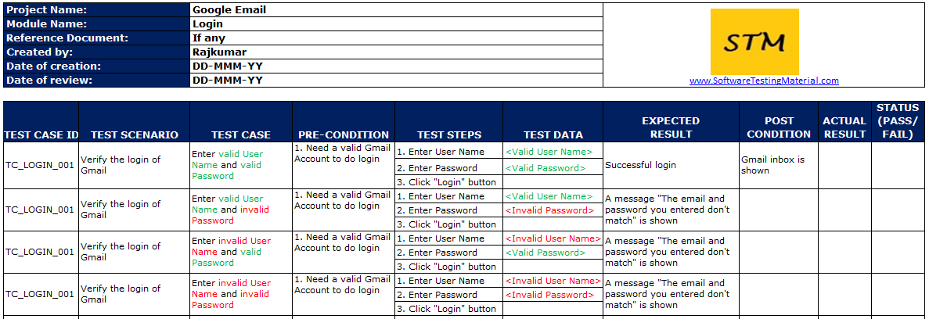
GENERAL TEST CASE TEMPLATE FORMAT
Test case template screenshot

Slide 6
HOW TO WRITE TEST CASES IN MANUAL TESTING
Steps to write the test cases.
Step #1 – Test Case ID:
Each test case should be represented by a unique ID. It’s good practice to follow some naming convention for better understanding and discrimination purposes.
Step #2 – Test Case Description:
Pick test cases properly from the test scenarios.
Example:
Test scenario: Verify the login of Gmail
Test case: Enter a valid username and valid password

Slide 7
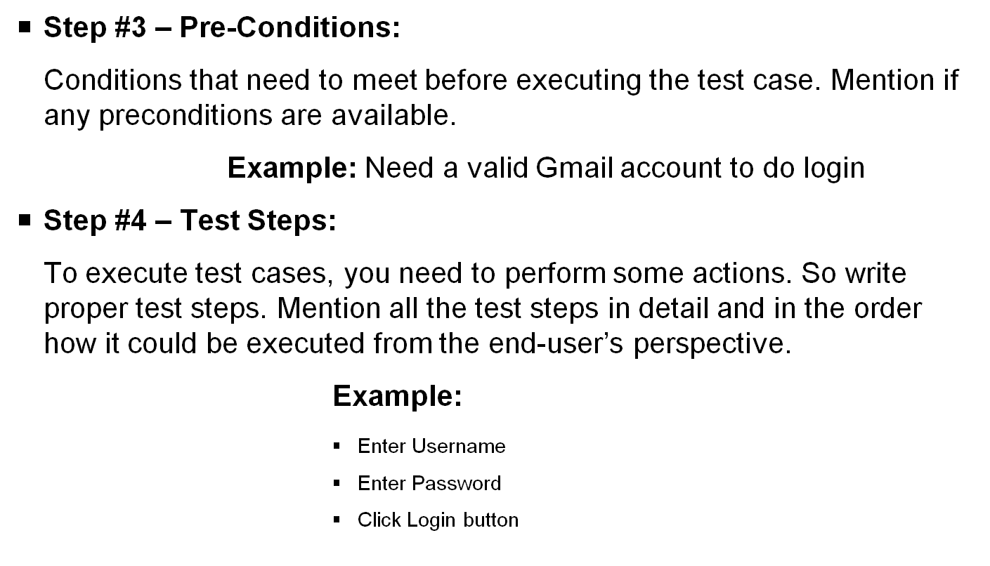

Slide 8
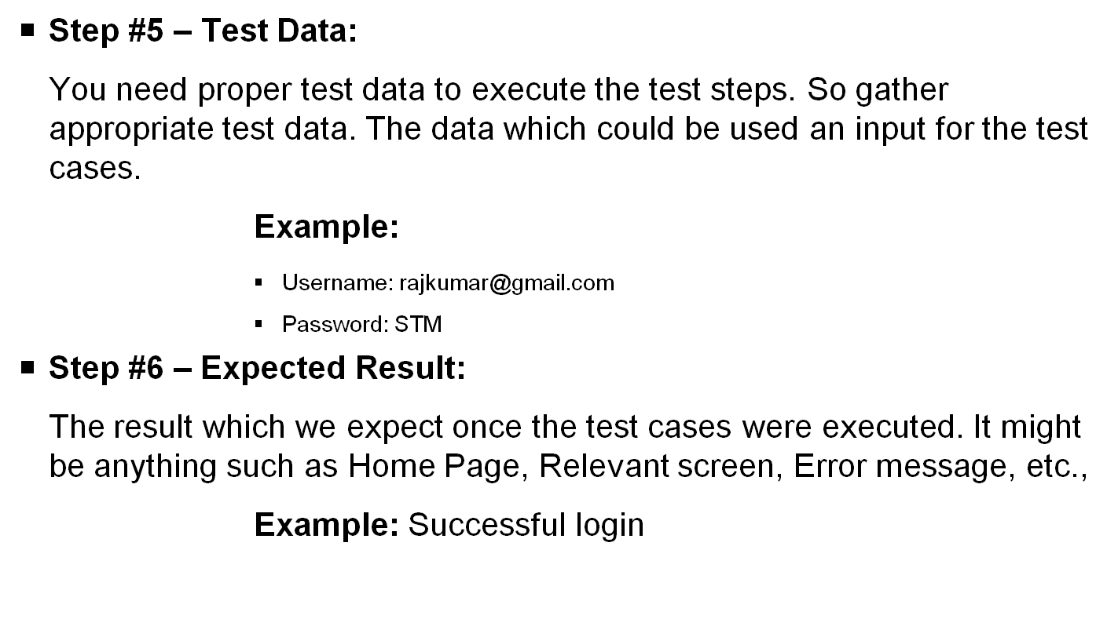

Slide 9
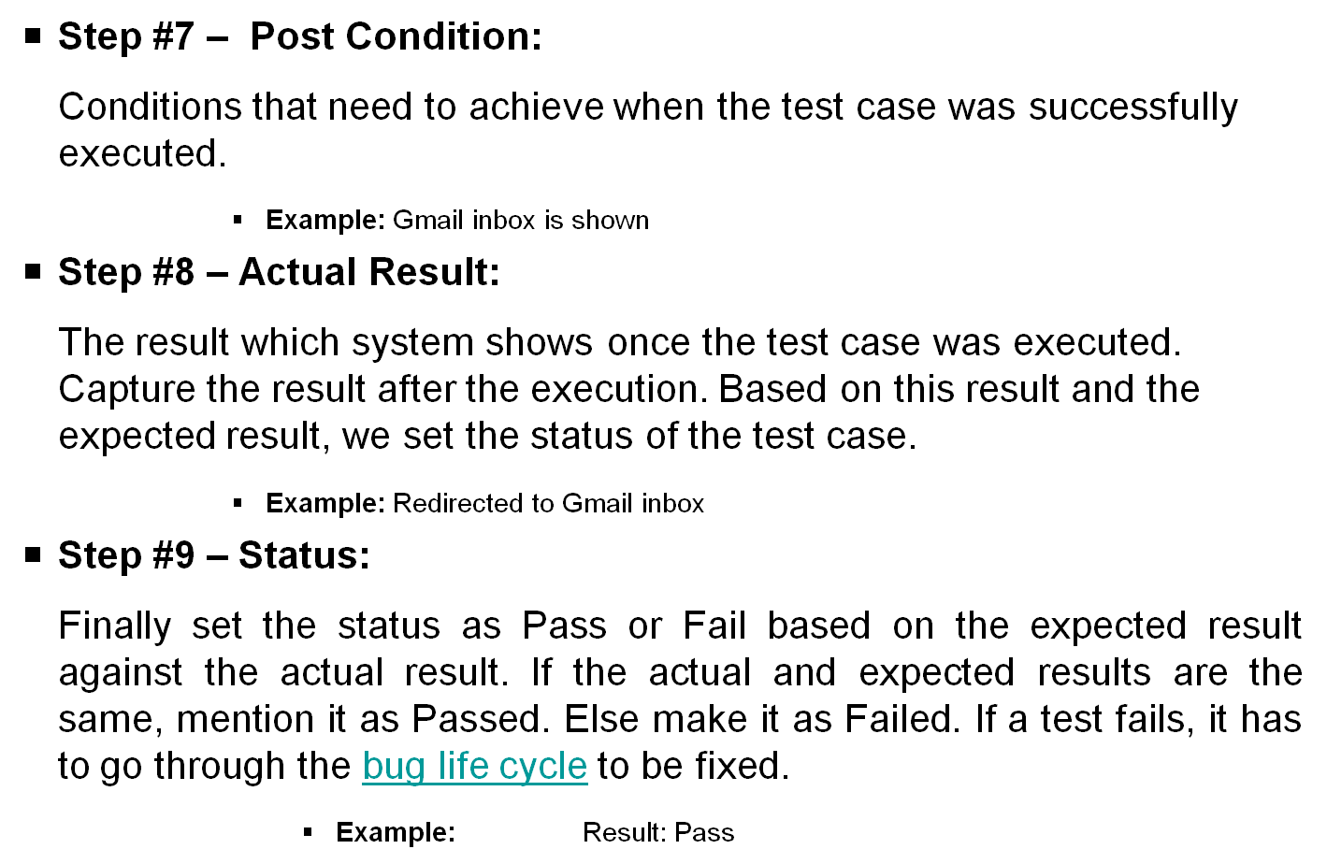

Slide 10
Other important fields of a test case template:
    Project Name: Name of the project the test cases belong to
    Module Name: Name of the module the test cases belong to
    Reference Document: Mention the path of the reference documents (if any such as Requirement Document, Test Plan, Test Scenarios, etc.,)
    Created By: Name of the Tester who created the test cases
    Date of Creation: When the test cases were created
    Reviewed By: Name of the Tester who created the test cases
    Date of Review: When the test cases were reviewed
    Executed By: Name of the Tester who executed the test case
    Date of Execution: When the test case was executed
    Comments: Include value information which helps the team.

Slide 11
BEST PRACTICES TO WRITE GOOD TEST CASE
Characteristics of a good test case are
Easy to understand and execute
Create Test Cases with End User’s perspective
Unique Test case Identifiers must be used. It allows us to track them easily.
Prerequisites should be listed clearly. Helps to execute the test case without any issues.
Test data should be defined to evaluate each functional area.
Test case description should be concise.
Test Steps should be in detail and clear.
Specify the exact expected result.
Position condition should be listed if any.
Test cases should neither too simple nor too complex.
Test cases must be distinctive. There should not be no repeated test cases.
Test cases should be written by following test case design technqiues.
Test cases must be comprehensible. So that any tester (even a newly appointed testers) can understand them by perusing once.
Needs to provide clear environment details where we need to execute them.
Test cases should be reusable & maintainable
Get peer review.
If you follow the best practices to write test cases then anyone in the team can understand and execute the well-written test case easily. It should be easy to read and understand, not only for whoever wrote it but also for other testers as well.

Slide 12
EASY TO UNDERSTAND AND EXECUTE:
To make the test cases easy to understand and execute faster we need to use simple and easy to understand language like “Go to login page”, “enter username”, “enter password”, “click on login button” and so on.
Create Test Cases with End User’s perspective:
Create test cases by keeping end-user in mind. The test cases you create must meet customer requirements.
Use unique Test Case ID:
It’s good practice to follow a unique id with some naming convention for better understanding and discrimination purposes.
Have a clear description:
Your test case description should be clear enough to understand what the tester is going to do with this test case.

Slide 13
Add proper preconditions & postconditions:
In some cases, test cases need to meet some conditions before execution or achieve some conditions after execution. These conditions we need to mention properly in the Pre and postconditions.
Specify the exact expected result:
Include the Expected result: Expected result tells us what will be the result of a particular test step. Testers decide the pass or fail criteria based on the expected result.
Test cases should be reusable & maintainable:
A well written test case is reusable and maintainable. There ar times where developers change the code, and testers need to update the test cases. If our test cases are easy to read and understand then it would be easy to update them not only by whoever wrote it but also by other testers as well.

Slide 14
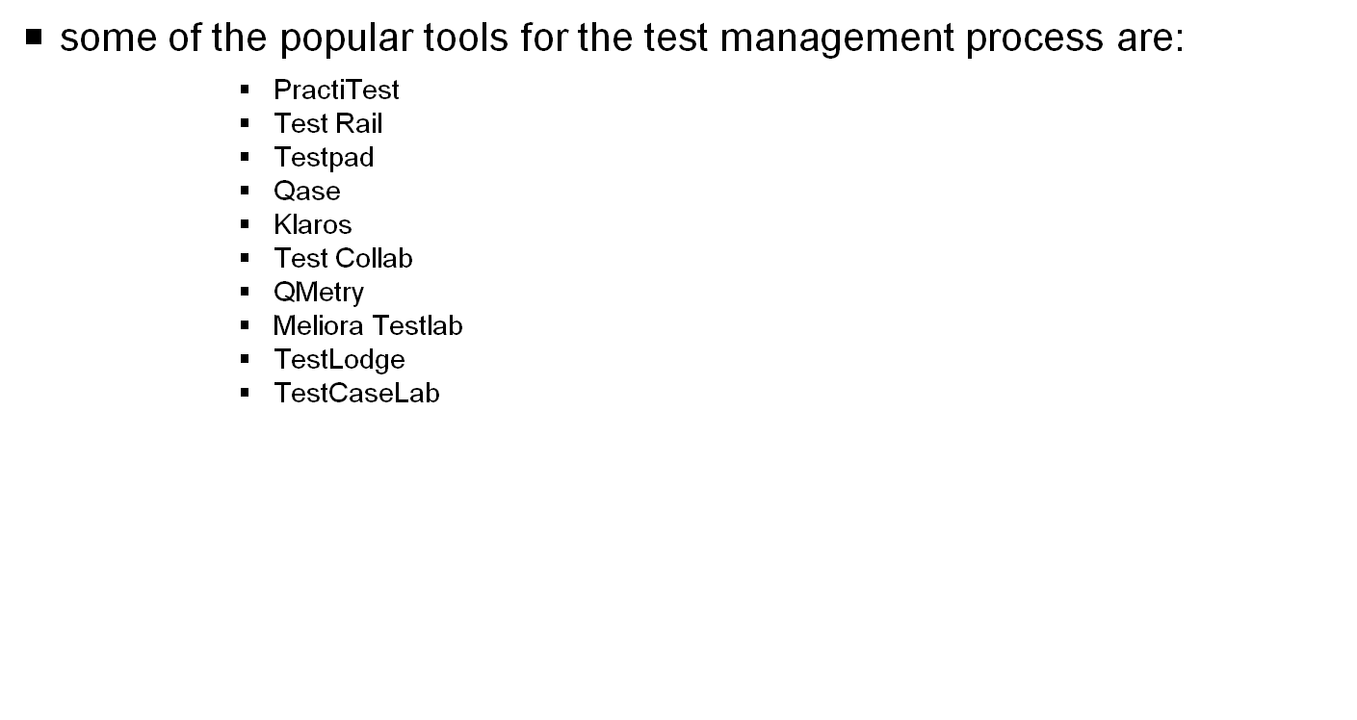
POPULAR TEST CASE MANAGEMENT TOOLS

Slide 15
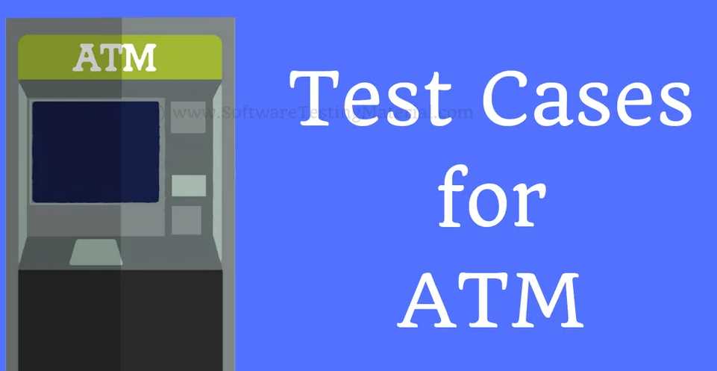

Slide 16
WRITE TEST CASES FOR ATM
ATM machines work 24×7 and its related to money. We need to test it for accuracy, reliability, and performance.
will list most of the test scenarios of ATM by covering major aspects of the ATM machine.
Following are the test cases for ATM Machine. The list consists of both Positive and Negative test scenarios login page.
Test Cases for ATM:
1. Verify the ‘ATM Card Insertion Slot’ is as per the specification
2. Verify the ATM machine accepts card and PIN details
3. Verify the error message by inserting a card incorrectly
4. Verify the error message by inserting an invalid card (Expired Card)
5. Verify the error message by entering an incorrect PIN

Slide 17
6. Verify that the user is asked to enter the PIN after inserting a valid ATM Card
7. Verify that PIN is encrypted
8. Verify that there is an action like blocking of card occurs when the total no. of incorrect PIN attempts get surpassed
9. Verify the user is allowed to do only one cash withdrawal transaction per PIN request
10. Verify the machine logs out of the user session immediately after successful withdrawal
11. Verify the message when there is no money in the ATM
12. Verify the language selection functionality
13. Verify the cash withdrawal functionality by entering some valid amount
14. Verify the cash withdrawal functionality by entering an amount less than 100
15. Verify the cash withdrawal functionality by entering an amount greater than the total available balance in the account.

Slide 18
16. Verify the cash withdrawal functionality by entering an amount greater than per day limit
17. Verify the user is allowed to enter the amount again in case the amount entered is not valid. A proper message should be displayed.
18. Verify the ATM machine successfully takes out the money.
19. Verify the ATM machine takes out the balance printout after the withdrawal
20. Verify the font of the text displayed in ATM screen
21. Verify the text on the screen buttons visible clearly.
22. Verify the functionality of all the buttons on the keypad
23. Verify the text on the buttons visible clearly.
24. Verify that touch of the ATM screen is smooth and operational
25. Verify the user is allowed to choose different account types like Savings, Current etc.,

Slide 19
26. Verify the different combinations of operation and check if there will be an electricity loss in the middle of the operation. If there is an electricity loss in the middle of the transaction then the transaction should be marked as null and the amount shouldn’t be disclosed to others.
27. Verify the functionality of the cash dispenser
28. Verify the functionality of the receipt printer
29. Verify whether the printed data is correct or not in the receipt
30. Verify how much time the system takes to log out.

Slide 20
Reference:
https://www.softwaretestingmaterial.com/

